Slide 1
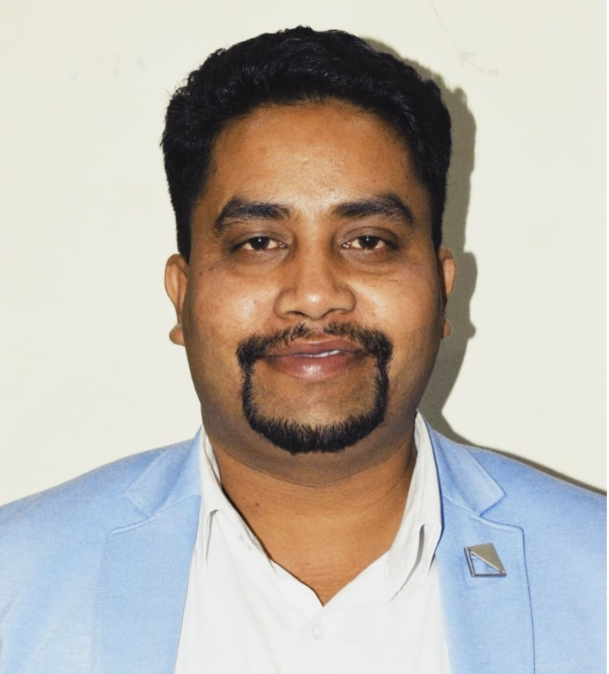
Multivariate Analysis
Factor Analysis, Cluster Analysis, Discriminant Analysis
DR.HITESH KUMAR SHARMA
Senior Associate Professor
Head of Department
Department of Computer Science

Slide 2
ABOUT ME
Senior Associate Professor & HoD, Dept. of Computer Science (UPES, Dehradun)
Academic Experience: 15+ Years
Academic Qualifications: Ph.D. (CSE), M.Tech (CSE)
5 Books Published
35 Patents Published
100+ SCI/Scopus/WoS Indexed Research Publications
02 Copyright Published
Delivered 10+ Keynote in Various Conferences
Delivered Guest Lecture in 20+ Institutions
Worked as IBM Instructor
Worked as Microsoft Instructor
DR.HITESH KUMAR SHARMA
Senior Associate Professor
Head of Department

Slide 3
Factor Analysis

Slide 4
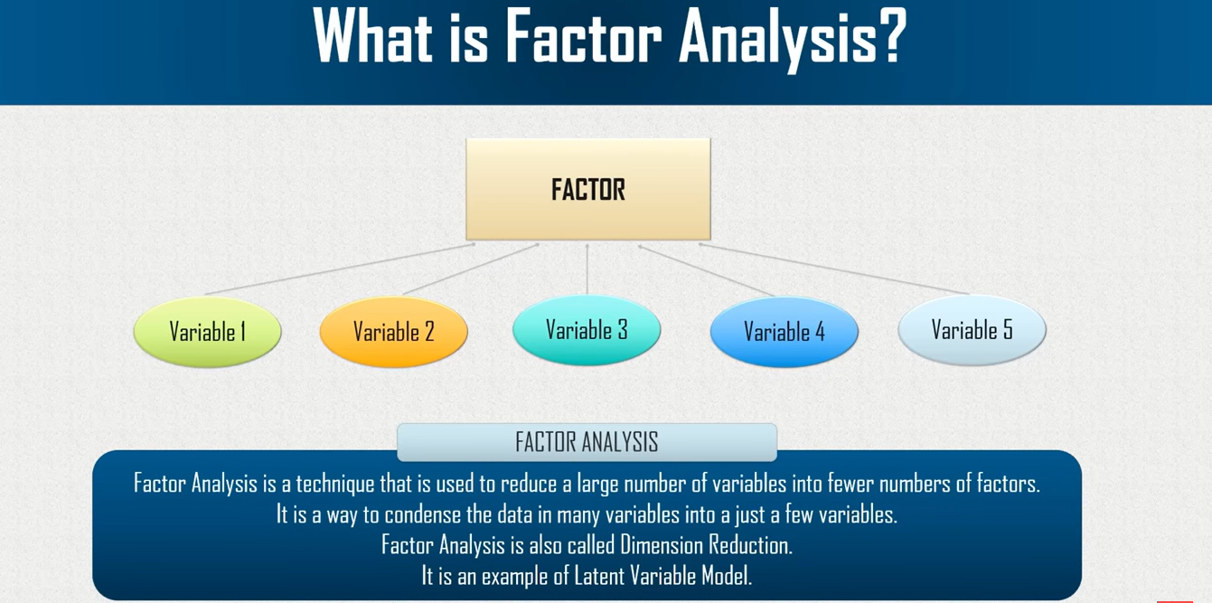

Slide 5
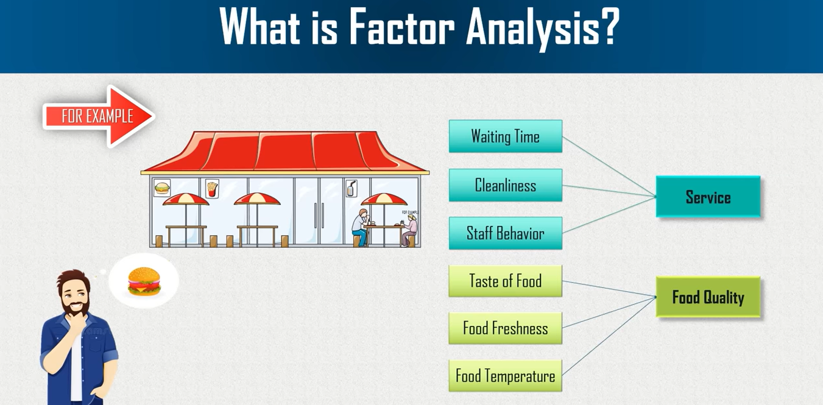

Slide 6
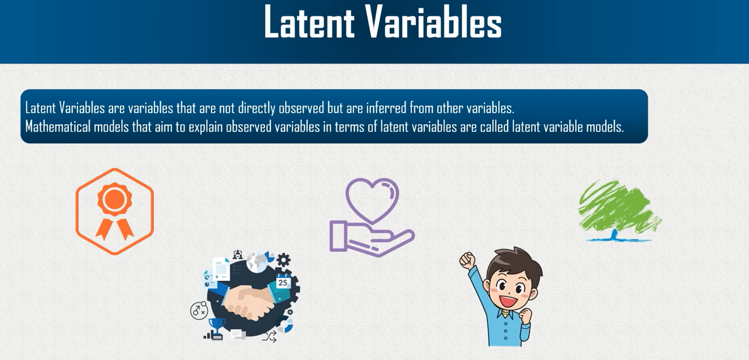

Slide 7
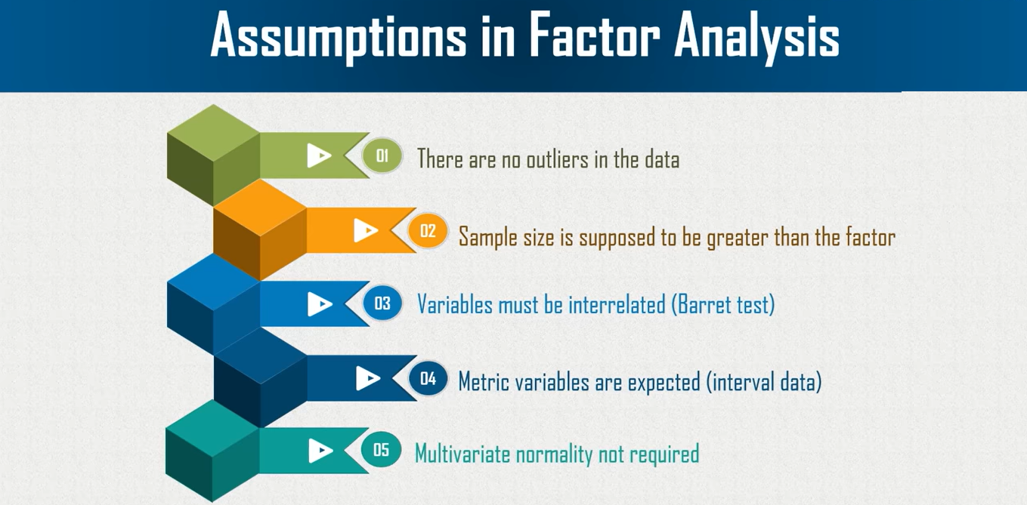

Slide 8
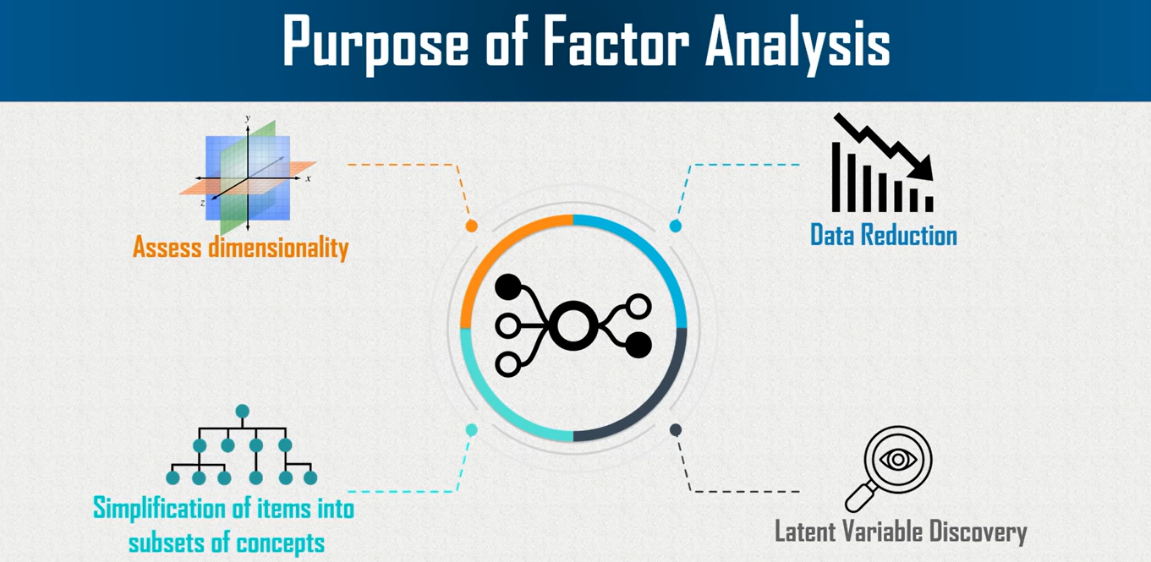

Slide 9
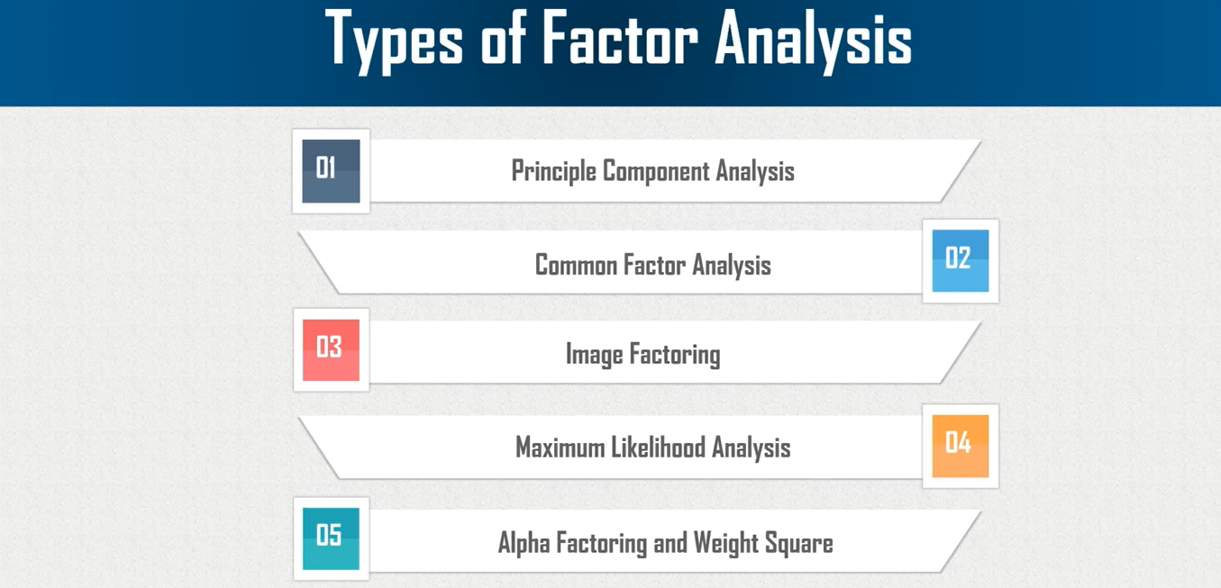

Slide 10
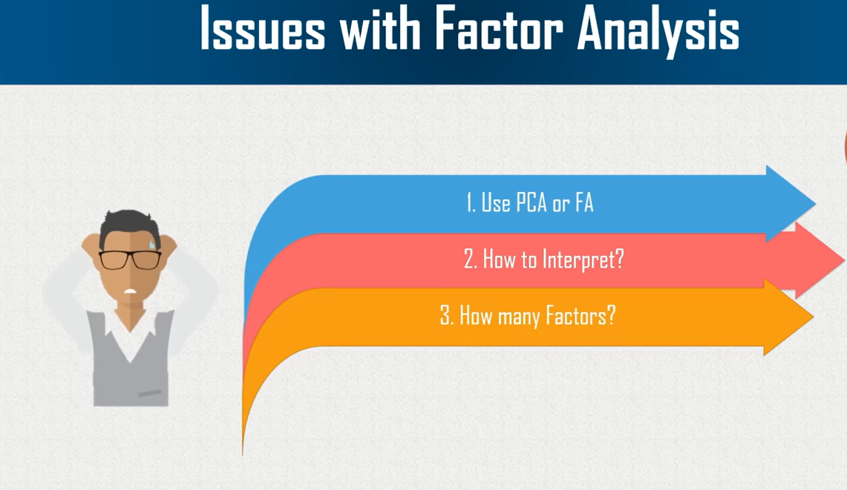

Slide 11
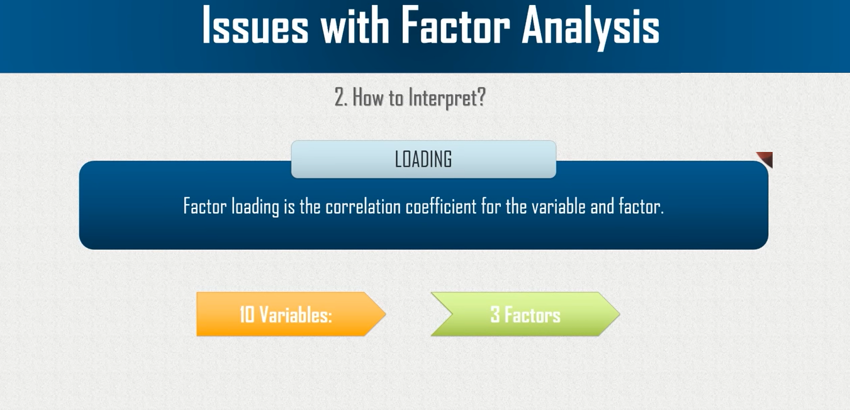

Slide 12
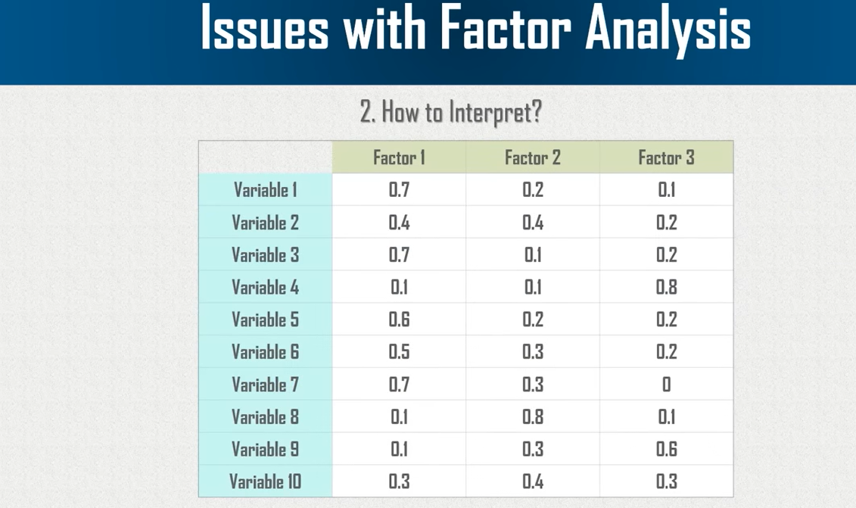

Slide 13
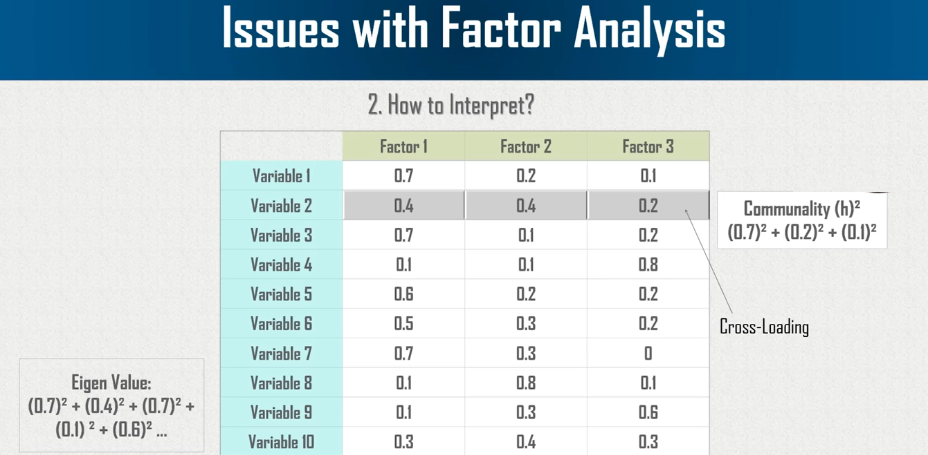

Slide 14
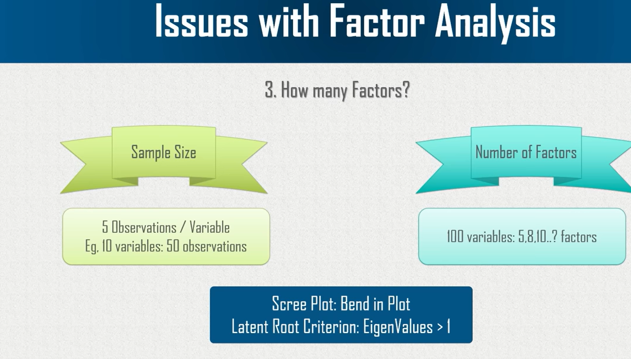

Slide 15
